Slide 1
SQL(Structured query language)
Used by many Relational Databases like Oracle, MySQL, Sybase, Ingres

Slide 2
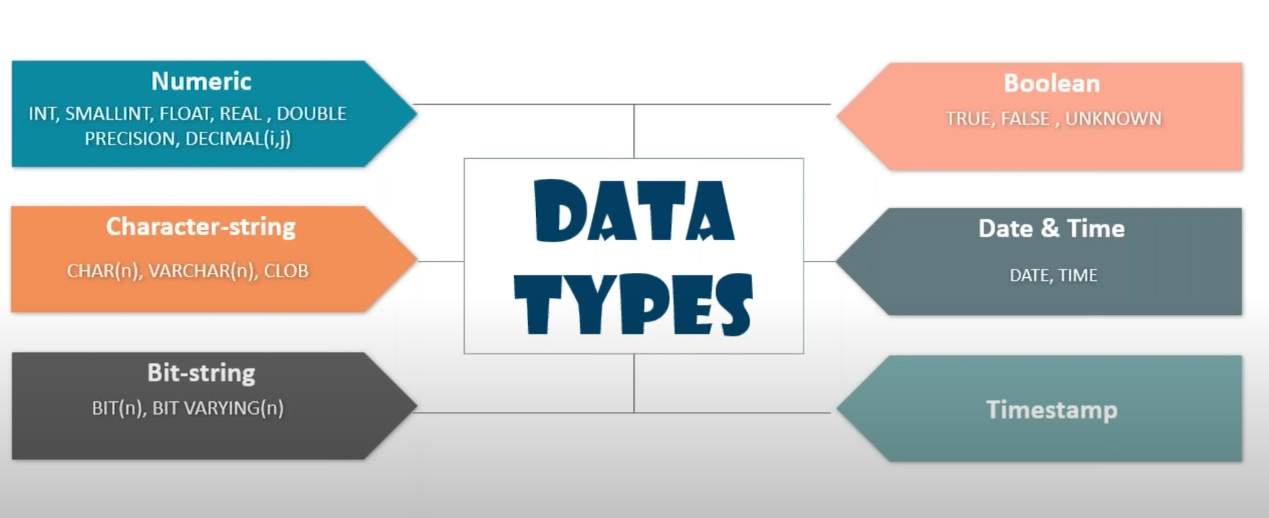
Data types in SQL

Slide 3
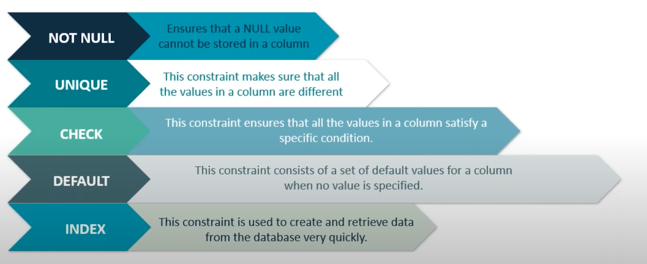
Constraints in SQL

Slide 4
Learning SQL Commands
Different category of command
DDL (Data Definition Language) – Create ,drop ,alter,rename,truncate
DML (Data manipulation Language) – insert , delete , update
DQL (Data Querying Language) – select
DCL (Data Control Language) – grant, invoke
TCL (Transaction Control Language) – commit, rollback, save point, set transaction

Slide 5
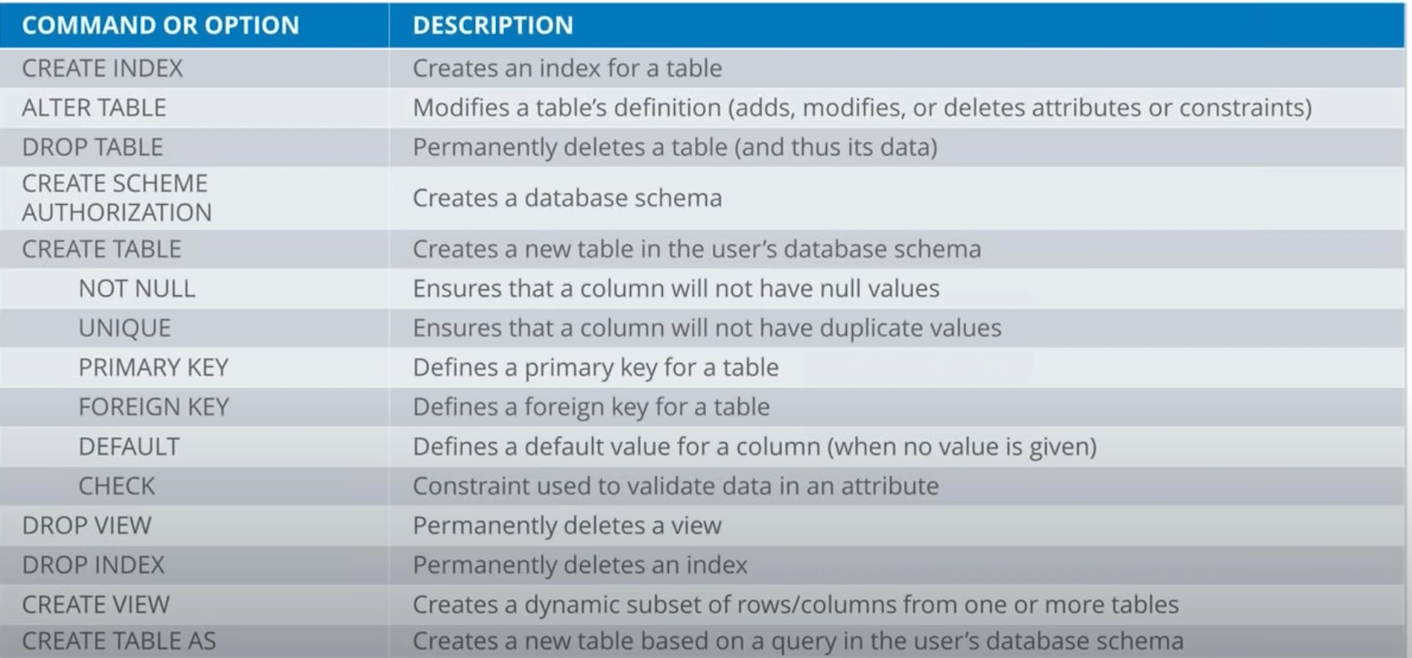
Data definition commands

Slide 6
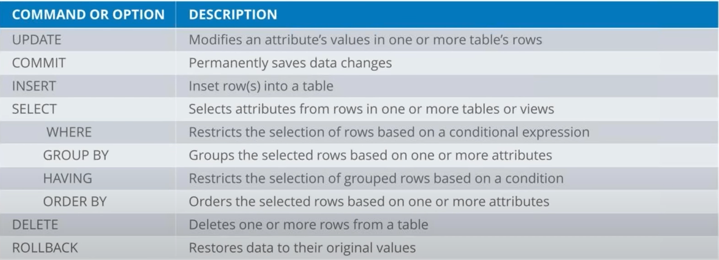
Data manipulation + Data control command

Slide 7
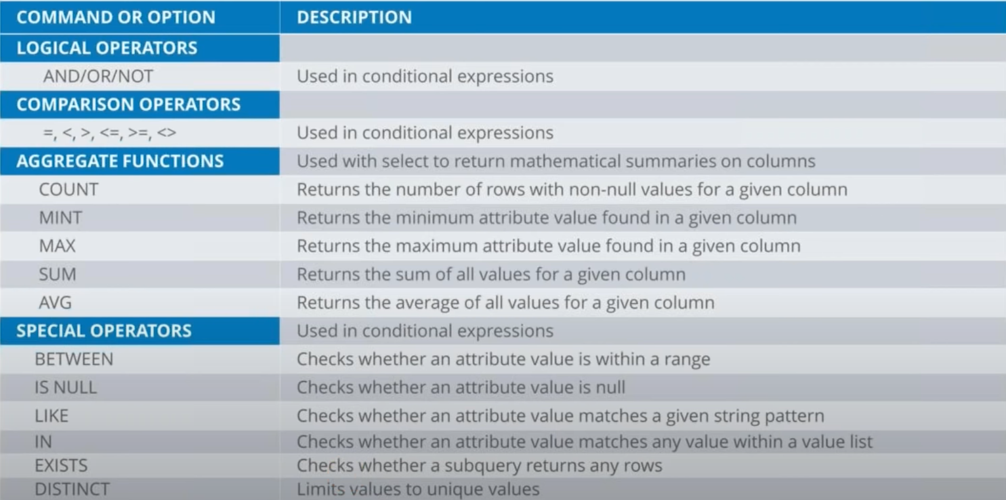
Continue…

Slide 8
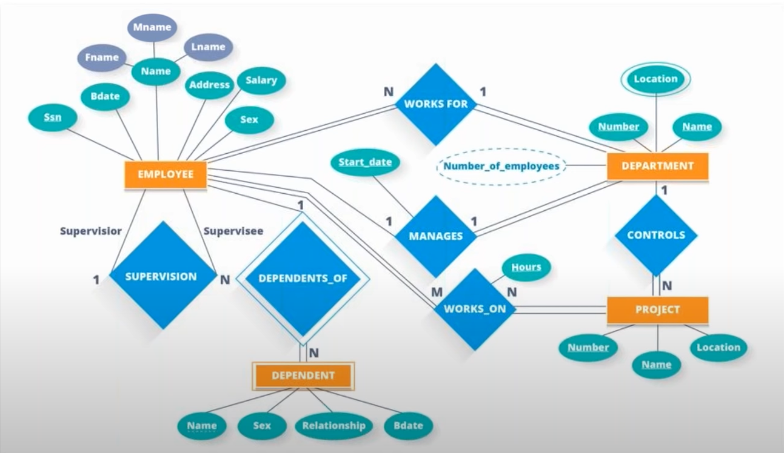
Hands on exercise

Slide 9
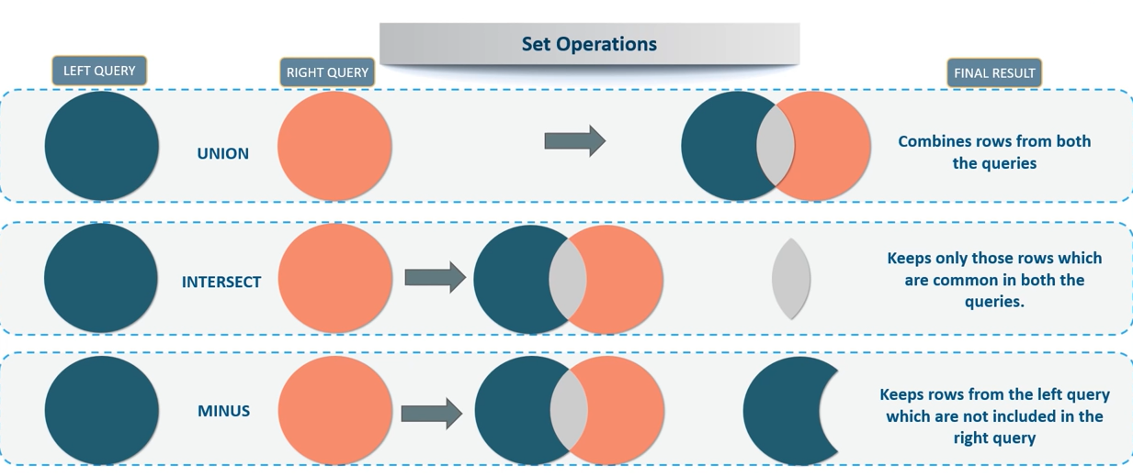
Relational Algebra and Relational calculus

Slide 10
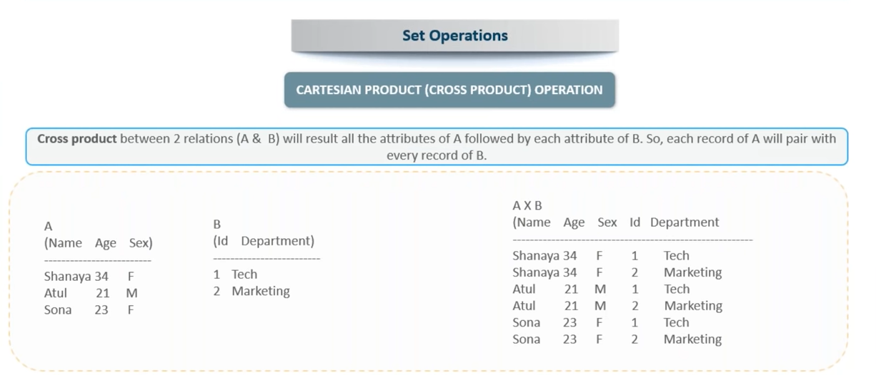
Continue…

Slide 11
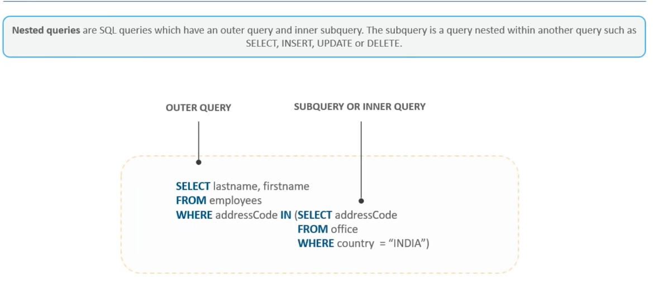
Nested query

Slide 12
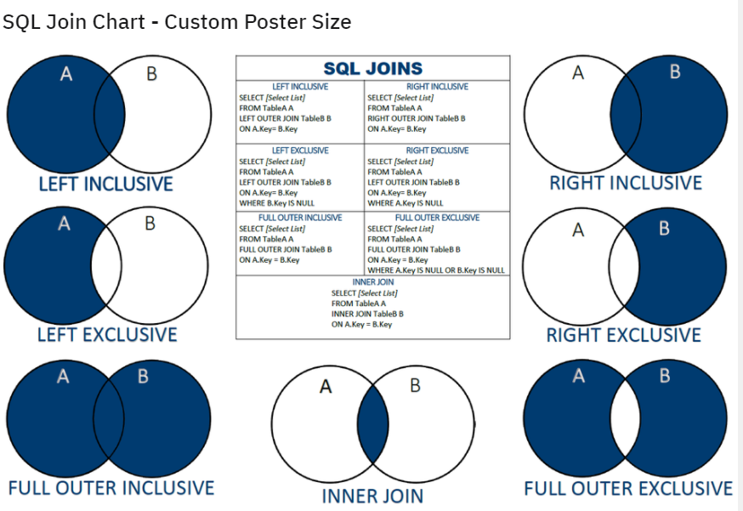
SQL JOIN

Slide 13
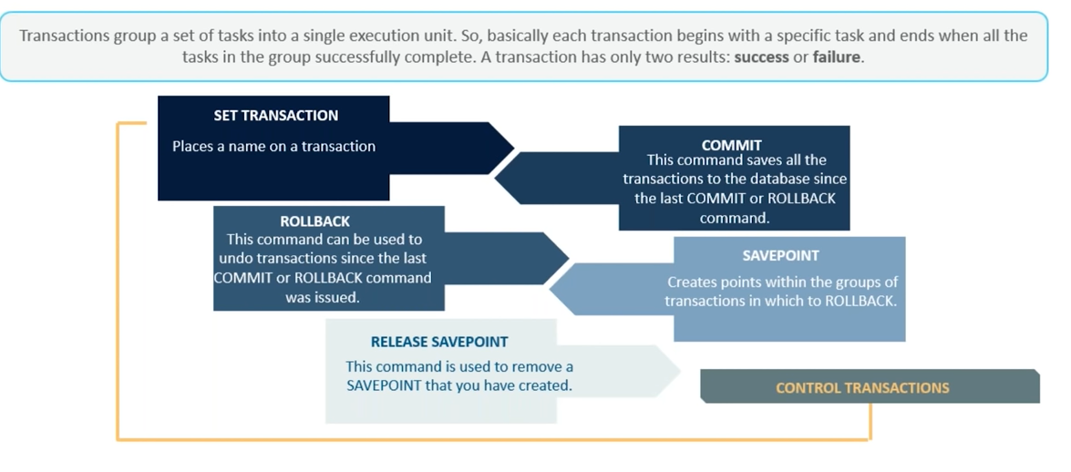
Transaction

